Slide 1
ORIGIN'26
Team SixSeven | Project: Origin — Campus ERP
Problem Statement: PS-6: ERP-based Integrated Student Management System
Name | Registration Number
Parth Pancholi | 25BCE10443
Adarsh Pratap Singh | 25BCE10285
Disha Dashore | 25BAI10444
Live Deployment: https://team-sixseven-erp.vercel.app/

Slide 2
The Problem Landscape
Current campus management relies on fragmented, inefficient, and error-prone systems.
Disconnected Systems: Institutes run admissions, timetables, attendance, fees, exams, and scores across disconnected spreadsheets and paper trails, creating communication silos.
No Single Source of Truth: Students, faculty, and admins each see a different, often stale, picture of the campus data. Resolving discrepancies takes weeks.
Manual Overheads: Wasted administrative hours on manual timetable re-staffing when a teacher is on leave, manual score entry, and manual fee reconciliation.
The Goal: Build one comprehensive ERP that acts as the central nervous system for the campus, keeping every interface reading from the exact same live data architecture.

Slide 3

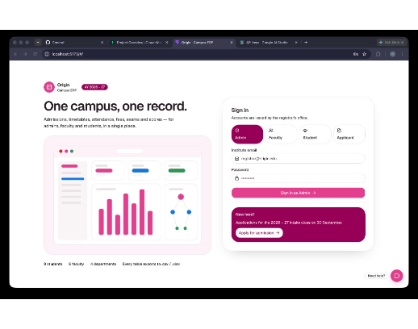
Our Proposed Solution
Unified Ecosystem: A single web app with four distinct role-based interfaces — Admin, Faculty, Student, Applicant — sharing one highly secure, MongoDB-backed API.
Real-Time Derivation: Every figure (attendance %, fees due, grades, timetable) is derived live from source records, not hand-entered or cached, eliminating discrepancies.
Smart Automation: Automatic timetable re-staffing seamlessly adapts around approved faculty leave without manual intervention.
AI Integration: A built-in AI chatbot acts as a virtual guide, helping applicants navigate admissions and the sign-in process effortlessly.

Slide 4


Core Capabilities & Features
Admissions & Access
Dynamic Scheduling
Role-based sign-in for all stakeholders from a single login portal. Features a complete admissions pipeline encompassing applications, approvals, rejections, and a live fee tracker.
An intelligent timetable engine that automatically regenerates based on teacher availability and approved leave. Includes per-exam marks entry with instant auto-computed grading.
Analytics & Finance
AI-Powered Assistance
Comprehensive finance dashboards tracking tuition, admission fees, and payroll. Offers rich force-directed network graphs for structural visualization and full CSV/XLSX export capabilities.
A Gemini-powered AI chatbot embedded directly into the login and application flow. Provides instant, accurate answers to common queries, reducing the burden on administrative support.

Slide 5
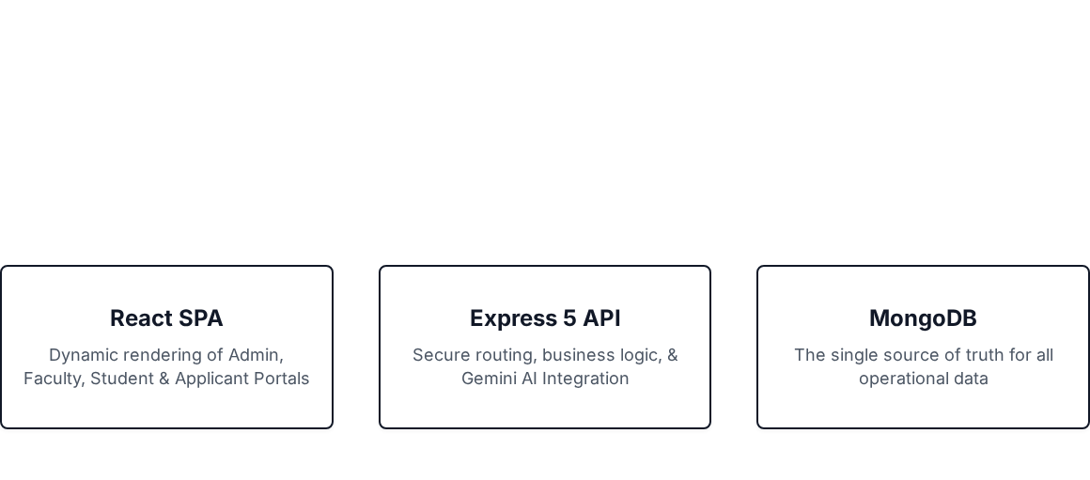
Tech Stack & Architecture
Frontend: React 19, React Router, Vite, Tailwind CSS v4, shadcn/ui, Framer Motion, React Flow, and react-force-graph-2d for advanced visualizations.
Backend: Node.js, Express 5, MongoDB, Mongoose 9, Google Gemini API for natural language processing.
Architecture: One Express API (/api) consumed by a single React SPA that renders distinct portals per signed-in role. No hardcoded or seeded data — everything reads and writes straight to the live database.

Slide 6


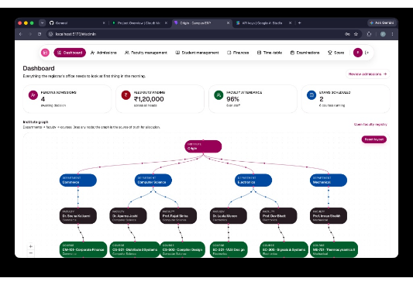
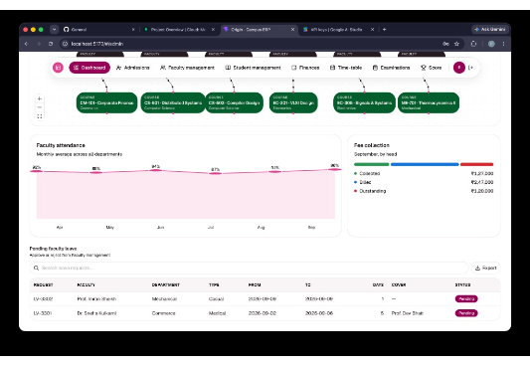
Admin Portal: Overview & Structure
Institute-wide Dashboard: High-level metrics on enrolment, staffing, and outstanding fees at a single glance.
Organizational Structure: Interactive React Flow chart visualizing the hierarchy from departments to faculty and courses.

Slide 7
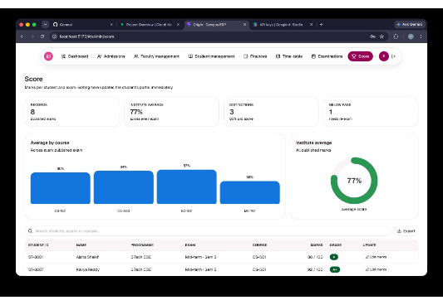
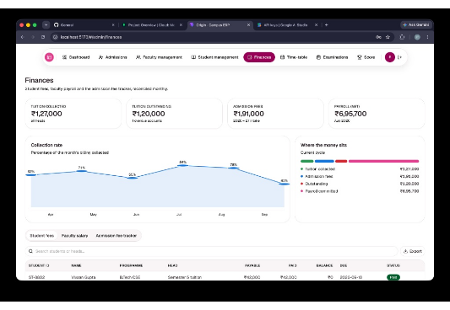
Admin Portal: Academics & Finances
Score Management: Detailed drill-downs of academic performance per department and individual student grading.
Financial Operations: Granular tracking of tuition collection, admission fees, and faculty payroll commitments.

Slide 8
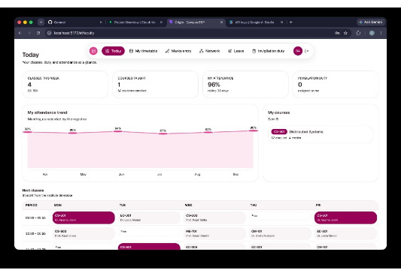
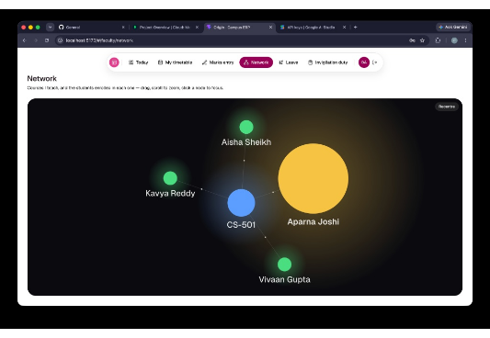
Faculty Portal
Personalized Dashboard: Faculty view of assigned courses, class schedules, attendance tracking, and marks entry interface.
Relational Network: Force-directed graph illustrating the faculty member's specific connections to taught courses and enrolled students.

Slide 9
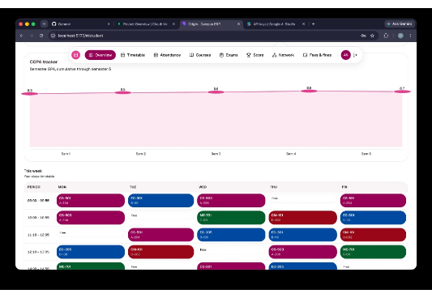
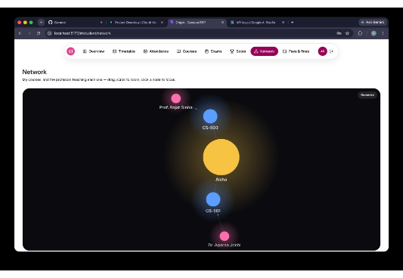
Student Portal
Academic Hub: Dashboard tracking personal attendance, fee dues, fines, and historical score data with CGPA trend charts.
Academic Network: Force-directed visualization mapping the student to their enrolled courses and the respective professors.

Slide 10






AI Chatbot Experience
Streamlining user onboarding and administrative support through intelligent automation.
Context-Aware Guidance
Secure & Jailbreak-Resistant
Graceful Escalation
Powered by the Google Gemini API, the chatbot sits directly on the login page, offering immediate, contextually relevant guidance for new applicants and existing users navigating the system.
The AI is designed to recognize its limitations. If a query falls outside its strict knowledge base, it gracefully apologizes and provides an automated fallback to the official support email channel.
Engineered with strict prompt boundaries. The bot delivers concise, 5-line answers and is heavily protected against prompt injection (jailbreaking) to maintain a professional and safe environment.

Slide 11
Absolute Data Integrity
Eradicating Data Silos
Consistency Checks: Continuous validation runs directly against the live database, ensuring referential integrity between students, courses, and fees.
Origin fundamentally changes how campus data is handled by eliminating isolated spreadsheets. The MongoDB architecture ensures that when a grade is updated by a faculty member, the student and admin see the change instantaneously.
Zero Stale Cache: Critical metrics like attendance percentages and financial balances are computed dynamically. Data never drifts into outdated cached states.
This "Single Source of Truth" model means zero reconciliation time at the end of semesters and complete transparency across all departments.
Role-Restricted Mutability: While everyone views the same underlying data, precise role-based access control determines exactly who can edit, approve, or delete records.

Slide 12
Conclusion & Future Scope
Origin effectively replaces fragmented administration tools with a unified, live, role-aware ERP. By ensuring Admin, Faculty, Student, and Applicant portals all read from an identical source of truth, operational efficiency is drastically improved.
Roadmap
Implementation of a production-ready payment gateway for seamless fee processing.
Development of dedicated iOS and Android mobile applications.
Integration of real authentication and SSO via institutional email infrastructure.
Expansion of predictive analytics for enhanced student performance tracking.
Deployment:https://team-sixseven-erp.vercel.app/

